Slide 1

Alum Rock Union Elementary School District
Breakfast and Salad Bar Offerings
Child Nutrition Services

Slide 2
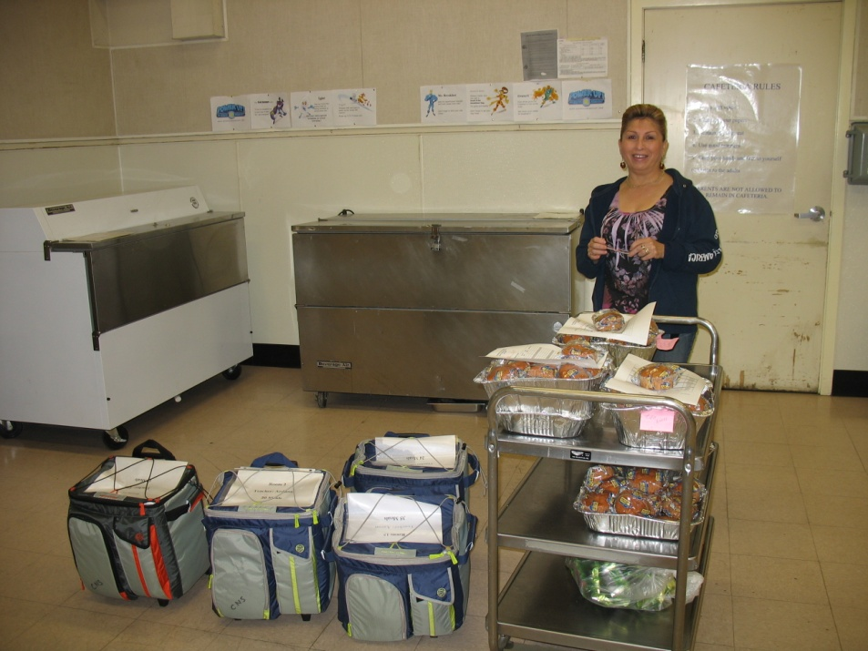
Breakfast in the Classroom
School Breakfast week in March
Promote breakfast the entire month
Goal to increase participation in breakfast at every school

Slide 3

Breakfast in the Classroom
Breakfast Challenge
Schools communicate with parents and students the importance of breakfast
Activities and events supporting the theme as a means to Fuel Your Body
Partnering with the SCCOE and Healthy Silicon Valley

Slide 4
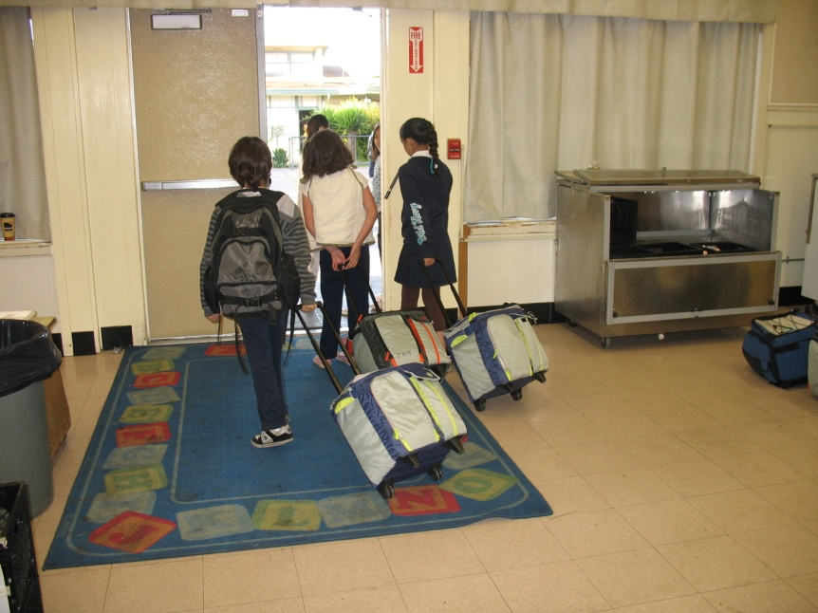
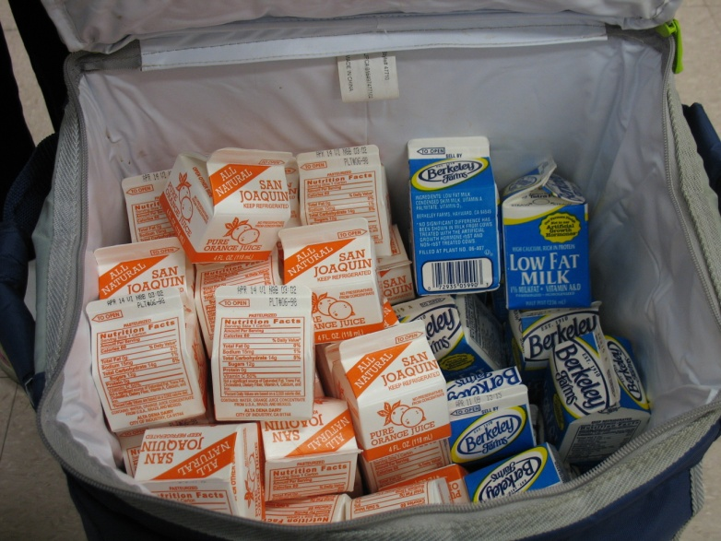
Breakfast in the Classroom
Alternative Solutions
Second Chance
Access to Fresh Fruit and Vegetables
Breakfast in the classroom

Slide 5
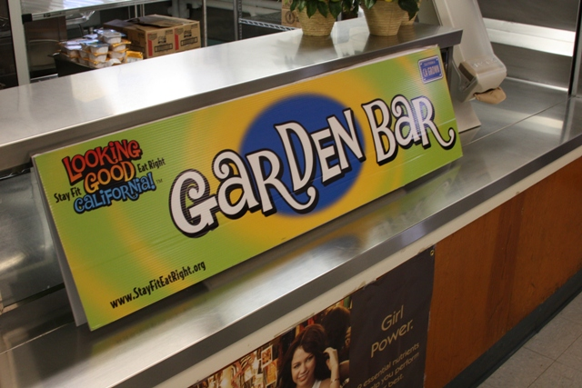
Salad Bar
Grant funded initiative
Salad provided at the salad bar during lunch service

Slide 6
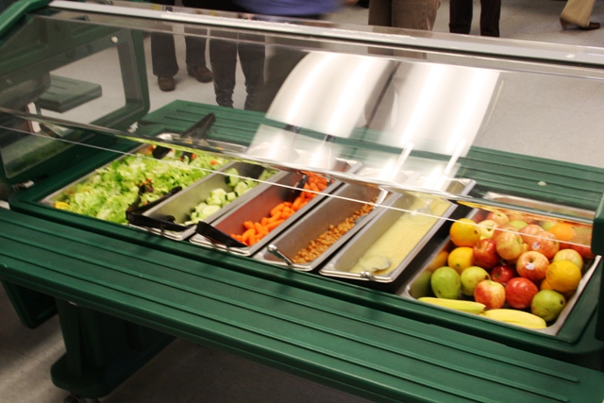
Salad Bar

Slide 7
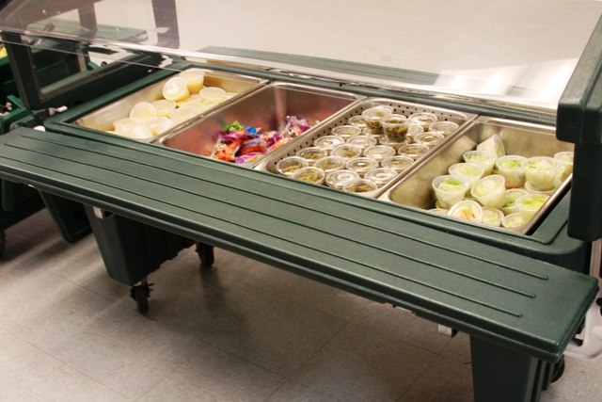
Salad Bar

Slide 8
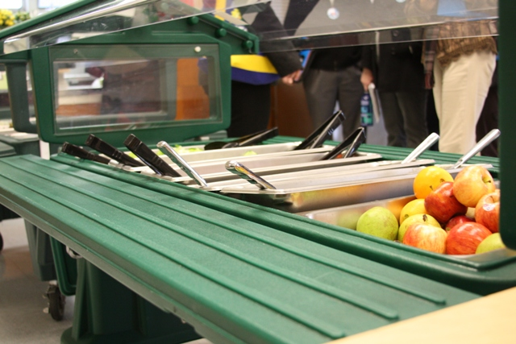
Salad Bar

Slide 9
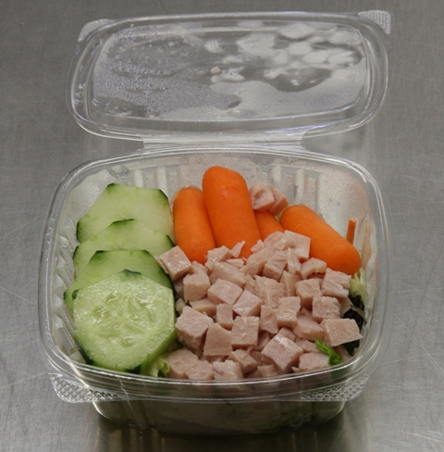
Salad Bar

Slide 10
Fresh Fruit and Vegetable Program
The CDE, through the Fresh Fruit and Vegetable Program (FFVP), will grant funds to school sites to provide students with a variety of free fresh fruit and vegetable snacks throughout the school day as a supplement to (and not part of) the school breakfast and school lunch programs, and to teach students about good nutrition. The FFVP encourages schools to partner with other entities in the community to support their efforts.

Slide 11
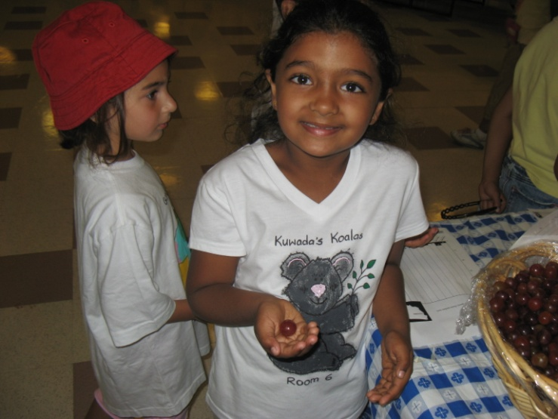
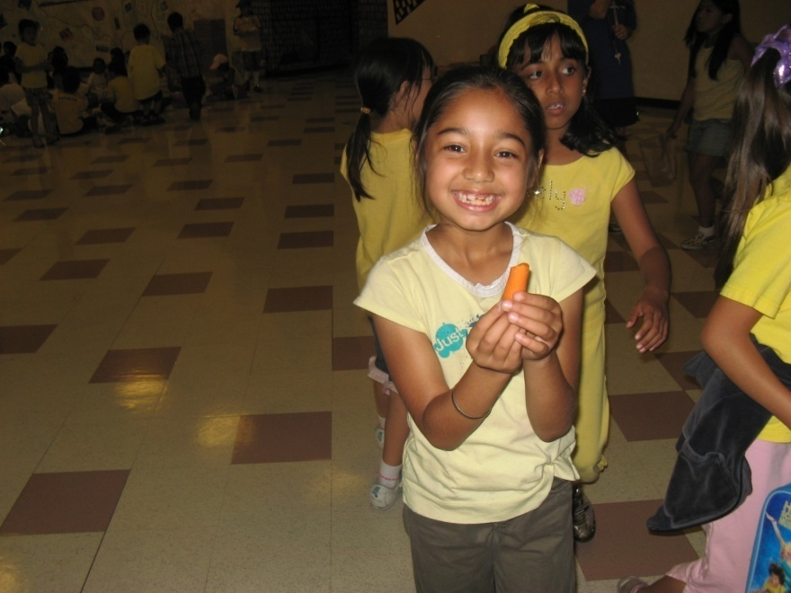
Fresh Fruit and Vegetable Program
Implementation
Benefits for schools

Slide 12

Questions
Breakfast
Salad Bar
Fresh Fruit and Vegetable Grant

